Slide 1
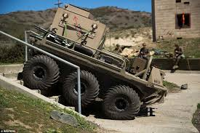
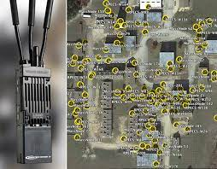
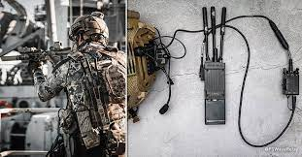
Urban Warfare Test Scenarios

Slide 2
Solution Overview
Objectives
MPU5 Gears & Accessories
Location 1 – Test Applications @ Base (BSEP)
Location 2a – Titiwangsa (@ Golf Club) to Compare Results
Location 2b – Wangsa Walk
Mobile - Convoy / Parallel Formation
Project Time-Line
Staffing & Resources
Environment (TB Finalised – Site Survey and Location of Each position)
Installation & Integration (TB Finalised) – Normal 4x4 cars + Foot Soldiers
Test Results

Slide 3
Objectives
Conduct RF Testing in Urban Environment to simulate the real engagement
Conduct Application Tests (BFT/Data/RoIP, RF Voice, Videos, etc.) to ensure MPU5 platform is delivering the needed data throughput and stability to support client’s requirements
Document all the test results

Slide 4
MPU5 Gears & Accessories
 | Command Center | 4 Vehicles 3 Units (4 X 4) 1 SUVE | Soldiers | Total
MPU5 (S-Band) | 1 | 4 | 7 | 8
High Gain Antennas | 3 | 3
Standard Antennas |  |  | 21 | 21
RF Voice | 1 | 1
RoIP 1 Port 2 Ports | 1 | 1
Data 1 – VPN (File)
Data 2 – Head 720 |  | 1 | 1
Data 3 – Video Cam |  | PC (?) | PC (?)
Data 4 – Video 1080
Data 5 – Run App
Data 6 – Run App
Teams to discuss & Finalized by Wk 2 of Jan
Please refer to Confirmed List to design the formation.

Slide 5
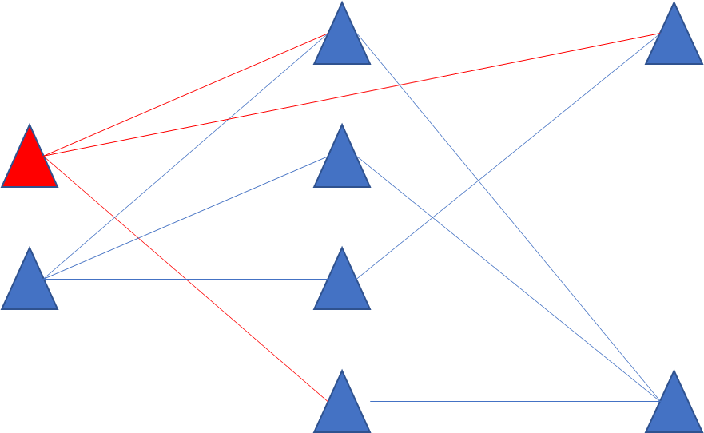
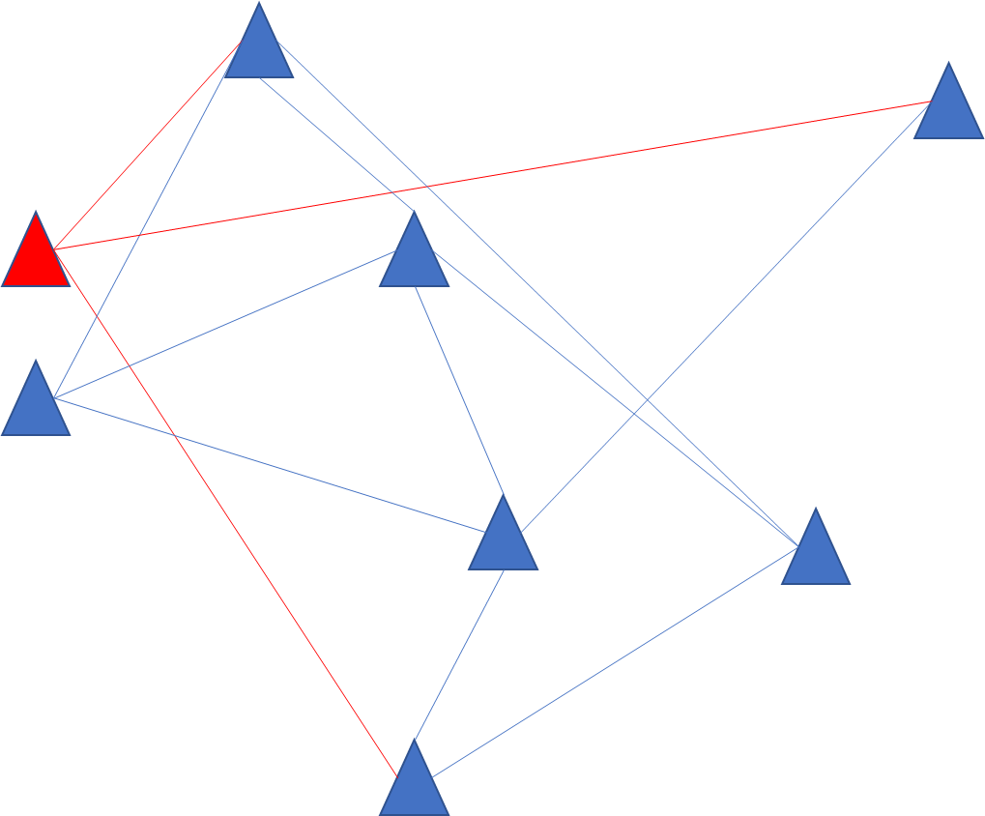
Urban Warfare – Test Applications @ BSEP
Distance Between MPU5
<250m | 1 - 500 | 1 - 1000 | 1 – 500 - 1000 - 2000 | 1501 - 2000
Application 1 (BFT) | Situation Awareness
RF Voice
RoIP 1 Port 2 Ports
Data 1 – VPN (File)
Data 2 – Head 720
Data 3 – Video Cam
Data 4 – Video 1080
Data 5 – Run App
Data 6 – Run App

Slide 6
Urban Warfare – Location 1 – Titiwangsa (Compare
Distance Between MPU5
<250m | 1 - 500 | 1 - 1000 | 1 – 500 - 1000 - 2000 | 1501 - 2000
SNR | Screen Shots
Ping Command To Any | Command To Nearest Middle Furthest
Throughput Command To Any | Command To Nearest Middle Furthest
Throughput / Any To Any (3 Sets) | Run 3 Sets Nearest Middle Furthest

Slide 7
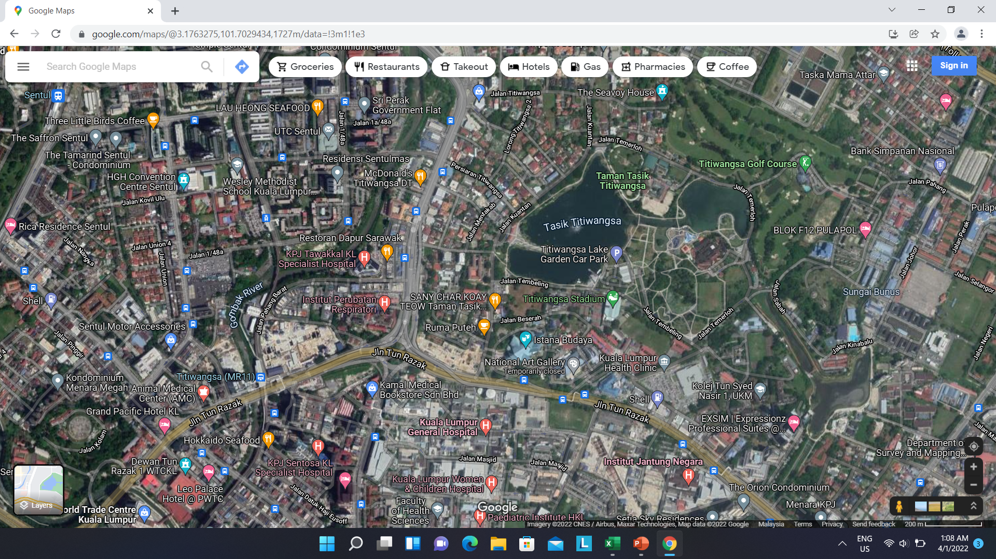
Urban Warfare – Location 1 – Titiwangsa (Compare)
FLAT ROAD WITH BUILDINGS TO BOUNCE OFF SIGNAL

Slide 8
Urban Warfare – Location 2 – Wangsa Walk
Distance Between MPU5
<250m | 1 - 500 | 1 - 1000 | 1 – 500 - 1000 - 2000 | 1501 - 2000
SNR | Screen Shots
Ping Command To Any | Command To Nearest Middle Furthest
Throughput Command To Any | Command To Nearest Middle Furthest
Throughput / Any To Any (3 Sets) | Run 3 Sets Nearest Middle Furthest

Slide 9
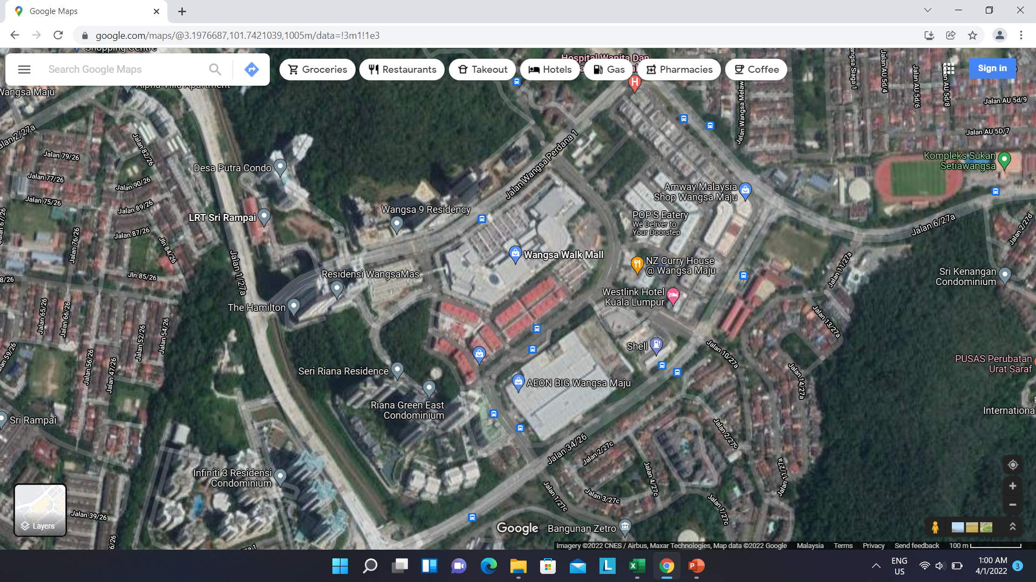
Urban Warfare – Location 2A – Wangsa Walk (~1km Radius)
BUILDINGS, FLAT, TREES AND HILL SLOPE TO BOUNCE OFF SIGNAL

Slide 10
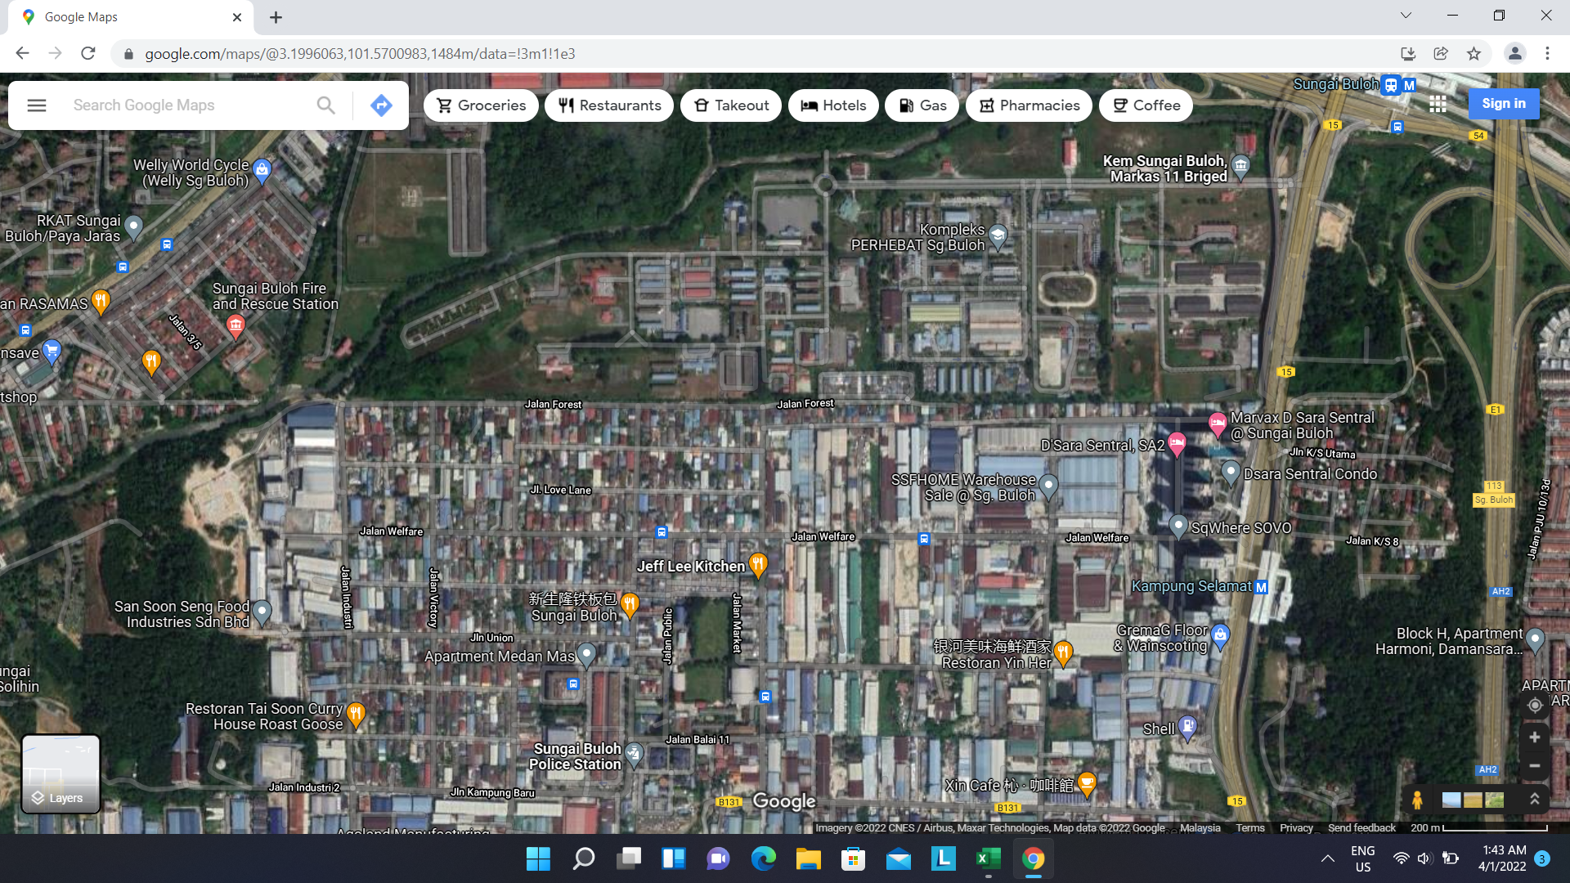
Urban Warfare – Location 2B – Sungai Buloh (~2KM Radius)
INDUSTRIAL FACTORIES (FLAT LAND)

Slide 11
Urban Warfare – Mobile – Convoy / Parallel
Distance Between MPU5
<250m | 1 - 500 | 1 - 1000 | 1 – 500 - 1000 - 2000 | 1501 - 2000
SNR | Screen Shots
Ping Command To Any | Command To Nearest Middle Furthest
Throughput Command To Any | Command To Nearest Middle Furthest
Throughput / Any To Any (3 Sets) | Run 3 Sets Nearest Middle Furthest

Slide 12
Urban Warfare – Mobile – Convoy / Parallel
CONVOY / PARALLEL (300m to 500m apart) – Speed
10-20km

Slide 13

Formation 2 – Mobile (Convoy / Parallel)
Convoy
Road
10-20km Speed
Parallel
Road
Road
10-20km Speed

Slide 14
Formation 1 - MESH
Note: We shall load the actual site with terrains and environment later.

Slide 15
Testing of Data Throughput (via different paths)
Note: We shall load the actual site with terrains and environment later.

Slide 16
Scheduled Time-Line / Day
9am to 10am | Breakfast Meeting - Set-Up Equipment - Briefing
10:00am | Location 1 | <250m 1 – 500m 1 – 1000m 1 – 500 – 1000 - 2000 | Data Tests | Applications Test
12:30pm | Lunch
2:00pm | Location 2 | <250m 1 – 500m 1 – 1000m 1 – 500 – 1000 - 2000
4:30pm | Mobile | Convoy Parallel
Teams to discuss & Finalized by Wk 2 of Jan

Slide 17
Staffing & Resources
 | Openapps | MOD | Spektrum/Cistech | Resources
Command Center | 3 Staff Situation Awareness RoIP RF Voice Data | 1 Staff (Major) RSD 1 Staff (Major) AirForce | 2 Staff (Emery – Controller) | MPU5 (High Gain) Desktop Walkie Talkie RF RoIP
Car 1 (4x4) | 1 Staff | 1 Soldier | Yew Wai | MPU5 (Standard) RoIP
Car 2 (4x4) | 1 Staff | 1 Soldier | POMEN (Contrator) | MPU5 (Standard) Data
Car 3 (SUV) | 1 Staff | 1 Soldier |  | MPU5 (High Gain)
Car 4 (Normal Car) | 1 Staff
Foot Soldier 1 | 1 Staff | 1 Soldier | FOS (Contractor) | MPU5 (Standard) Head Cam
Foot Soldier 2 | 1 Staff |  |  | MPU5 (Standard) Head Cam
Foot Soldier 3 | 1 Staff |  |  | MPU5 (Standard)

Slide 18
Installation & Integration
 | Resources
Command Center
Car 1 (4x4) | Mount
Car 2 (4x4) | Mount
Car 3 (SUV) | Mount
Car 4 (Normal Car)
Foot Soldier 1 | Jacket
Foot Soldier 2 | Jacket
Foot Soldier 3 | Jacket
Teams to discuss & Finalized by Wk 2 of Jan

Slide 19
Test Results
 | RF (SNR) | Data | RoIP | RF Voice (Dual PTT)
Base (BSEP) | Screenshots
Titiwangsa
Wangsa Walk
Sungai Buloh Camp
Convoy / Parallel
A detailed Test Plan to be forwarded later this week.
Key is to agree on the structure!

Slide 20
Ref – Confirmed List of Equipment
Persistent Systems P/N | Quantity | Description
WR-5100 | 6 | MPU5 Chassis w/battery
ANT-4001 | 6 | GPS Antenna
RF-2150 | 6 | High Powered S-Band Radio Module
WR-INT-ANT-SYS-01 | 1 | S-Band Integrated Antenna
BAT-11 | 1 | 2-Bay Battery Charger
ANT-2005 | 18 | 2.1 - 2.5 GHz 2.15 dBi Omnidirectional Gooseneck
ANT-2037 | 6 | 2.2 - 2.5 GHz 2 dBi Horizontal Polarized Omnidirectional
ANT-2010 | 9 | 2.2 - 2.5 GHz 8.5 dBi Omnidirectional Antenna
ACC-MNT-MPU5-0007 | 3 | Magnetic Vehicle Mount
WR-PTT-SYS-01 | 3 | Dual PTT System
ACC-AUD-073-R | 3 | Stereo Headset
WR-DISP-SYS-01 | 1 | Rugged Display Controller
CBL-DATA-2001 | 2 | 22-Pin to Ethernet Receptacle
CBL-DATA-2019 | 2 | 22-Pin USB to Ethernet Cable
CBL-DATA-2003 | 2 | MPU5 USB Cable
CBL-014 | 1 | IP67 RJ45 to Standard RJ45
CBL-086 | 1 | IP67 RJ45 to IP67 RJ45 - Shield Terminated

